Slide 1
Investigating research into EAP Assessment Literacy: implications and recommendations for the IFP and cross-curricular collaboration
Dr Anthony Manning
a.manning@kent.ac.uk

Slide 2
Outline
1- Defining terms and setting the scene
2- Research objectives and research questions
3- Supporting literature
4- Research design, methods and analysis
5- Findings
6- Recommendations/Actions
7- Limitations
8- Thematic bibliographies

Slide 3


Defining terms & setting the scene
Stiggins (1995) is generally accredited with introducing the term Assessment Literacy to describe the dangers which arise for stakeholders when tests are poorly built and inaccurately interpreted.
From the perspective of Educators, Stiggins (1995) suggests that practitioners with limited assessment literacy do not understand how to produce high-quality achievement data and are unable to evaluate critically the data they use.
Brindley (2001) notes that there is a lack of prominence attributed to assessment in teacher education courses. The density of language testing literature may also alienate classroom practitioners as it is written from the theoretical perspective of research academics in the field rather than classroom practitioners.

Slide 4
Defining terms & setting the scene
Aspects of assessment literacy, (Stiggins, 1995, p.240)
Assessment Literacy involves:
Approaching assessment with the full knowledge of what is being assessed
Understanding the purpose of assessment
Familiarity with the available means of assessing the achievement in focus
The expertise to generate sound samples of performance
An awareness of what can go wrong and how problems can be prevented before they arise.

Slide 5

Research objectives
Relevance to IFP
The key role of EAP provision on IFPs
The impact of EAP on IFP progression
The relative accessibility of cross-curricular collaborative opportunities
The objectives of this project were to:
Investigate the assessment literacy of EAP teachers,
based on the good practice highlighted in in relevant research
collect data from relevant EAP practitioners which could be considered representative of the sector
analyse the data and make recommendations for the sustenance and enhancement of EAP teacher assessment literacy, so that stakeholders can benefit from changes to EAP assessments; professional development or training
Promote ongoing attention to the need for high-quality testing and assessment in EAP, the results of which can be used to draw trustworthy inferences.

Slide 6

Research questions
Relevance to IFP
High number of EAP practitioners engaged in IFP provision
Access to examples of cross curricular assessment
Varied training backgrounds and experiences of assessment
The research questions which drove the research project were as follows:
To what extent do EAP teacher views on EAP testing and assessment practices reflect language testing research and practices which comprise Assessment Literacy?
How can EAP Assessment Literacy be sustained or enhanced?
The research hypothesis which was tested was:
EAP teachers who are involved in EAP testing and assessment have certain identifiable development requirements with regard to their knowledge and ability to implement assessment good practice and recommendations stemming from research.
EAP teachers who are involved in EAP testing and assessment do not have any identifiable development requirements with regard to their knowledge and ability to implement assessment good practice and recommendations stemming from research.
Null Hypothesis

Slide 7


Supporting literature
Key proponents of Assessment Literacy
Features of Assessment Literacy and examples of supporting research in Education, Applied Linguistics
Guidance resources for the development and enhancement of EAP Assessment Literacy.
Training for teacher Assessment Literacy through general and EAP teacher education
University-led EAP Assessment Literacy through in-house testing
Fulcher
Popham
Price et al.
Bachman
Stiggins
BALEAP
Messick
Taylor
Sharpling
Inbar-Lourie
O’Sullivan
Bailey & Brown
U of Reading
Shohamy
Weir
Coniam
Sharpling
Davidson & Lynch
Wallis
Davies et al
Blue et al
Fulcher
Popham

Slide 8
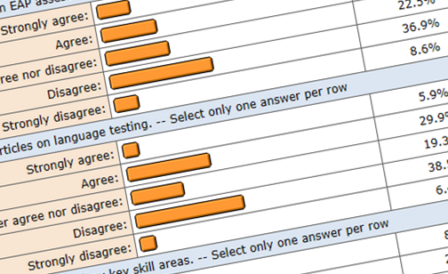

Research design, methods & analysis
Review of possible philosophies
Adoption of a pragmatic paradigm
Use of mixed methods of data collection
Quantitative and qualitative
Online survey (187 recipients)
  Bristol Online Surveys
25 research interviews
  Face-to-Face & Via Telephone/Skype
Datta, L. (1994). Paradigm wars:A basis for peaceful co-existence and beyond. In C. S. Reichardt & S. F. Rallis (Eds.), The Qualitative Quantitative Debate: New perspectives (Vol. 61, pp. 85-91). San Francisco, CA: Jossey-Bass.
Dörnyei, Z. (2007). Research methods in applied linguistics: quantitative, qualitative, and mixed methodologies. Oxford: Oxford University Press.
Duff, P. (2002). Research approaches in applied linguistics. In R. B. Kaplan (Ed.), The Oxford handbook of applied linguistics (pp. xxvii, 641 p.). Oxford: Oxford University Press.
Gorard, S. (2001). Quantitative methods in educational research : the role of numbers made easy. London: Continuum.
Greene, J. C. (2008). Mixed methods in social inquiry. San Francisco, Calif.: Jossey-Bass ; Chichester : John Wiley [
Relevance to IFP
Methodology aligns with cross-curricular nature of IFPs
High number of research respondents likely to be engaged in IFP provision
Outcomes likely to be relevant to IFP practitioners
Guba, E. G., & Lincoln, Y. S. (2005). Controversies, Contradictions, Confluences. In N. K. Denzin & Y. S. Lincoln (Eds.), The Sage handbook of qualitative research (3rd ed., pp. 200-201). Thousand Oaks, Calif.; London: Sage.
McNamara, T. F. (2003). Tearing us apart again: The paradigm wars and the search for validity Eurosla Yearbook, 3, 229-238.

Slide 9
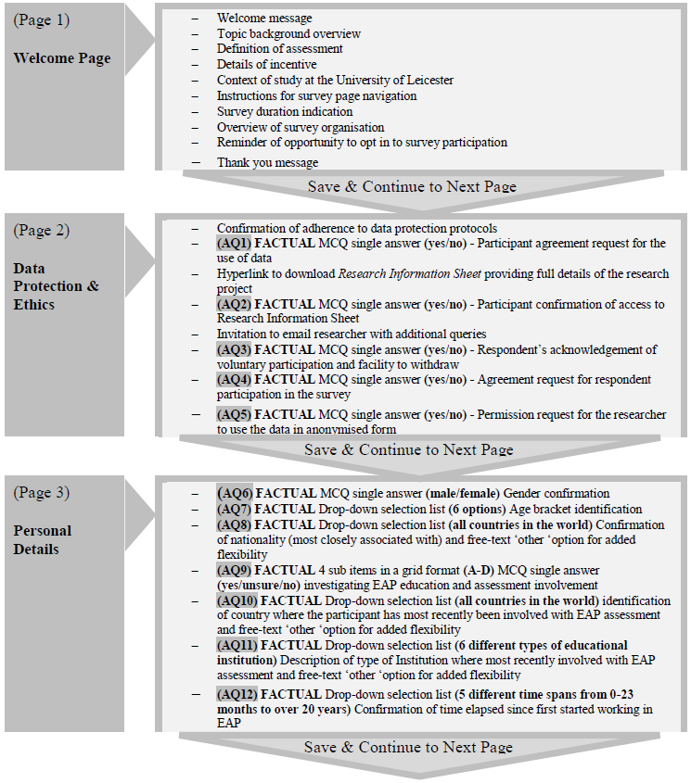
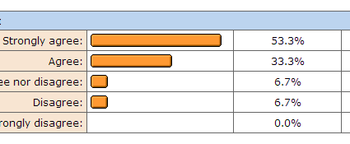

Questionnaire Structure
Training, skills, strengths and weaknesses in EAP testing and assessment
Approaches to EAP testing and assessment design
Views on/ experience of validity and reliability in EAP testing and assessment
Practices involving analysis and interpretation of the results and scores of EAP tests and assessments
Consideration of ethics in EAP testing and assessment
Influence of research and other resources for the purpose of EAP testing and assessment on EAP teacher Assessment practices

Slide 10
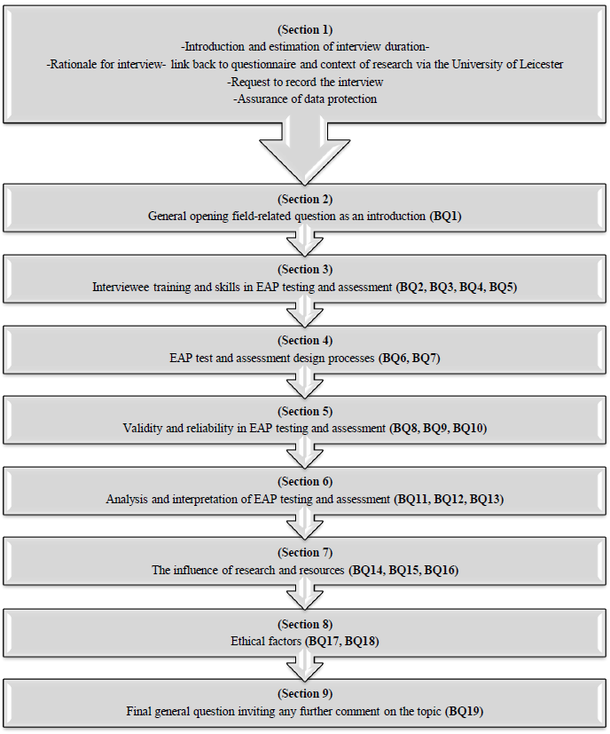


Interview Structure
Training, skills, strengths and weaknesses in EAP testing and assessment
Approaches to EAP testing and assessment design
Views on/ experience of validity and reliability in EAP testing and assessment
Practices involving analysis and interpretation of the results and scores of EAP tests and assessments
Consideration of ethics in EAP testing and assessment
Influence of research and other resources for the purpose of EAP testing and assessment on EAP teacher Assessment practices

Slide 11
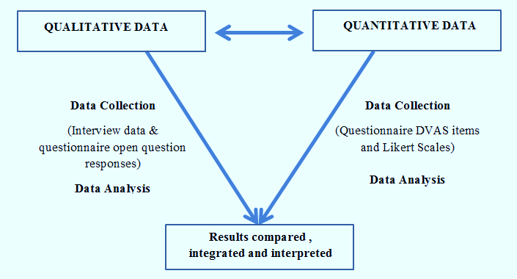
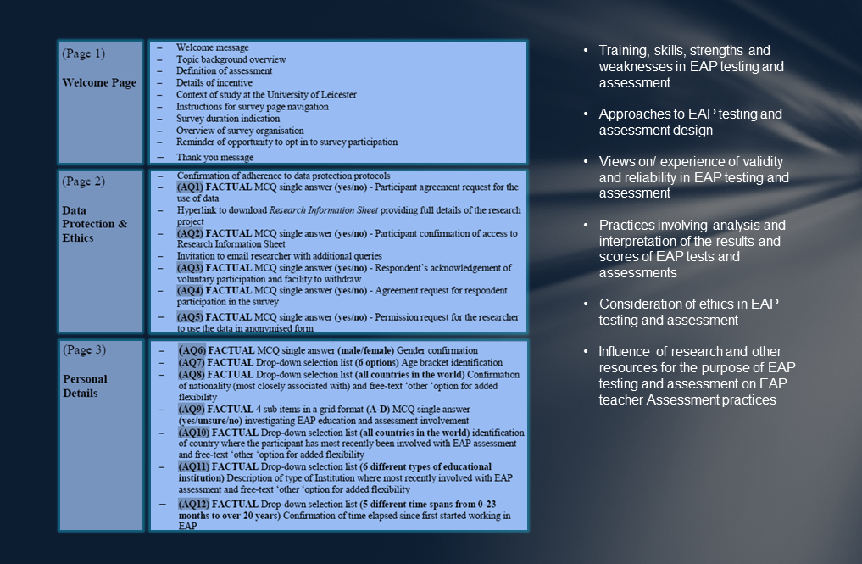
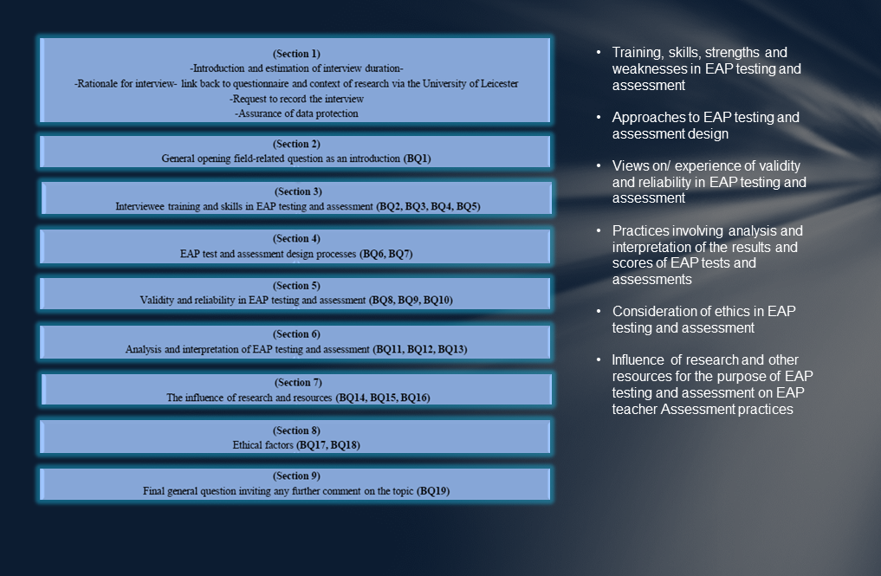
Research design, methods & analysis
TRIANGULATION

Slide 12

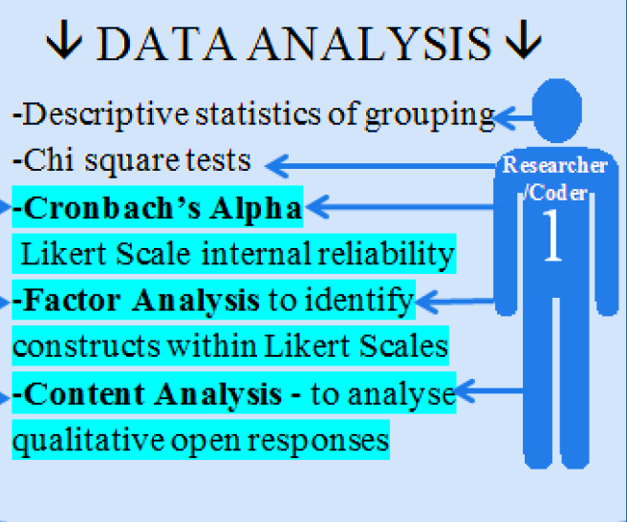
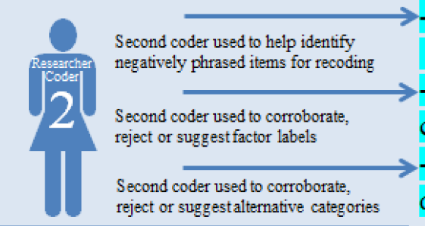
Research design, methods & analysis

Slide 13

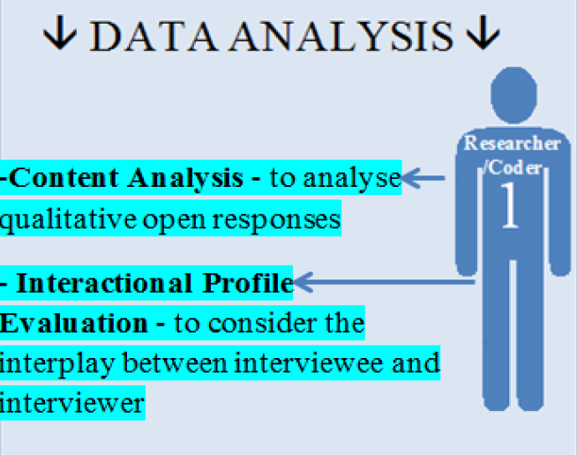
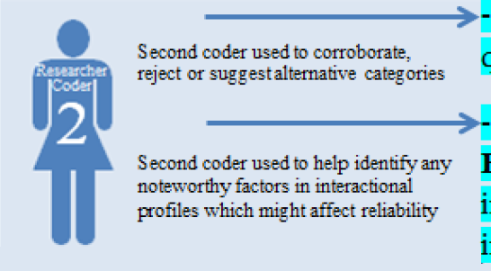
Research design, methods & analysis

Slide 14
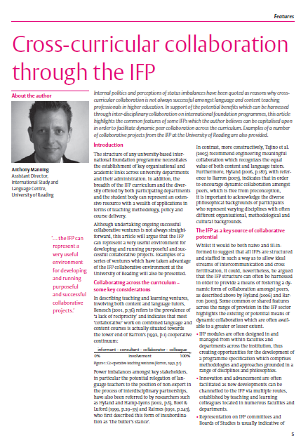
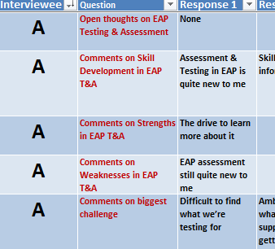
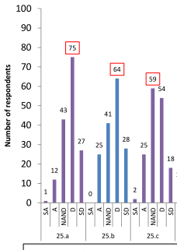
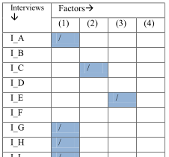
Findings
There is a need for more structured training interventions associated with EAP assessment- The same is likely to be true for other IFP modules
There is a lack of reference, amongst practising EAP teachers who assess, to research associated with assessment- Colleagues working on other IFP modules may also benefit from enhanced access to user-friendly materials
There appears to be an interest in additional opportunities for collaboration amongst EAP practitioners both within and across institutions and with content teachers
There is a need to extend practitioners’ skills in interpretive EAP assessment, including use of statistics- again opportunities for collaboration
There are key concerns amongst practitioners with regard to the ethicality of assessment

Slide 15

Return to research questions
The research questions which drove the research project were as follows:
To what extent do EAP teacher views on EAP testing and assessment practices reflect language testing research and practices which comprise Assessment Literacy?
How can EAP Assessment Literacy be sustained or enhanced?
The research hypothesis which was tested was:
EAP teachers who are involved in EAP testing and assessment have certain identifiable development requirements with regard to their knowledge and ability to implement assessment good practice and recommendations stemming from research.
EAP teachers who are involved in EAP testing and assessment do not have any identifiable development requirements with regard to their knowledge and ability to implement assessment good practice and recommendations stemming from research.
Null Hypothesis

Slide 16

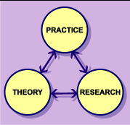

Limitations
Opinions of teachers regarding their own assessment literacy rather than a more objective measure of Assessment Literacy
Questionnaire respondents were restricted to practitioners with membership of professional bodies, which may have excluded less engaged practitioners
A greater number of questionnaire respondents and interviewees may have influenced the nature of the data gathered
Additional time devoted to the piloting stage could have resulted in the honing of certain items
With a trained interviewer interactions may have yielded more accurate information
Closing the gap between theory and practice
Relevance to IFP
Although respondents/interviewees make a lot of reference to cross-curricular collaboration, the respondents were focused on EAP rather than content module provision

Slide 17


Recommendations & Actions
Provision of a framework for in-service EAP assessment training- There is also an clear interest in additional collaboration which includes assessment for content teachers on IFPs
The creation of an online annotated bibliography for EAP assessment literacy- Such a resource would also be relevant to non EAP teachers on IFPs
Promotion of collaborative research and learning opportunities in assessment on programmes such as IFPs
Development of interpretive EAP Assessment Literacy skills including user-friendly statistical analysis training- Clear opportunities to learn from colleagues with statistical skills
The raising of awareness about the key importance of ethicality as an aspect of EAP Assessment Literacy- Working on IFPs brings together a wide group of stakeholders which can be used as a resource for this

Slide 18
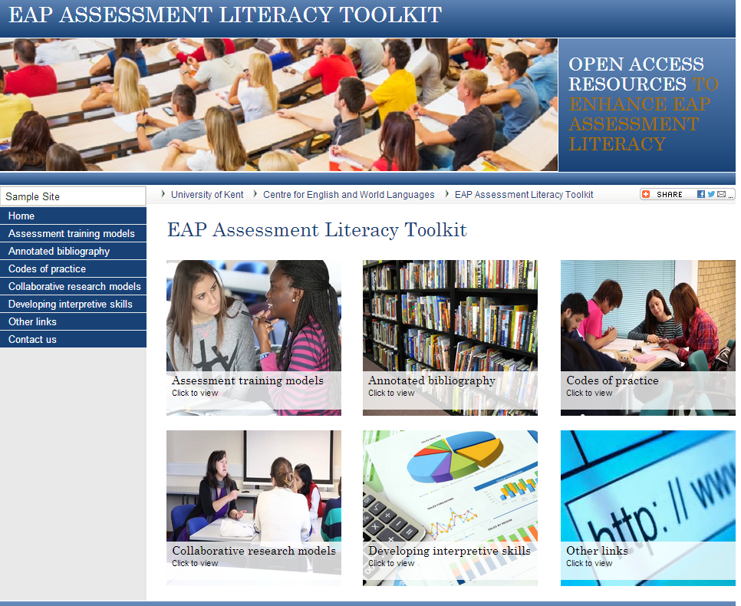
Recommendations & Actions
Provision of a framework for in-service EAP assessment training- There is also an clear interest in additional collaboration which includes assessment for content teachers on IFPs
The creation of an online annotated bibliography for EAP assessment literacy- Such a resource would also be relevant to non EAP teachers on IFPs
Promotion collaborative research and learning opportunities in assessment on programmes such as IFPs
Development of interpretive EAP Assessment Literacy skills including user-friendly statistical analysis training- Clear opportunities to learn from colleagues with statistical skills
The raising of awareness about the key importance of ethicality as an aspect of EAP Assessment Literacy- Working on IFPs brings together a wide group of stakeholders which can be used as a resource for this

Slide 19


How could you help?
Contribute good practice models for assessment related training that EAP and content tutors are engaged with on your programmes- to share good practice
Suggest additions to an online annotated bibliography for assessment literacy- to keep the resource up to date
Promote collaborative research opportunities in assessment development on your IFPs
Encourage the development of interpretive EAP Assessment Literacy skills including statistical analysis training- gain support from your statistics colleagues
Continue to encourage good practice and to raise awareness about the key importance of ethicality- Consult codes of conduct and make people aware of how test results can be best interpreted and how they are flawed

Slide 20
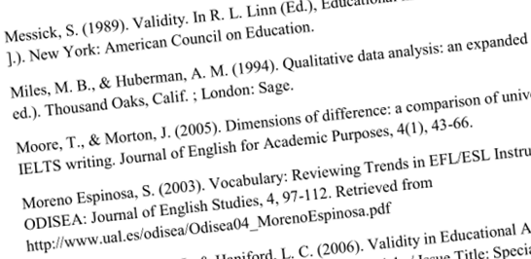
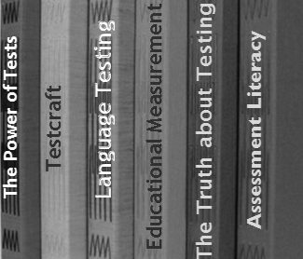
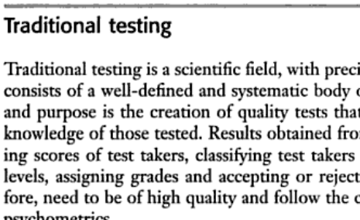
Thematic Bibliographies

Slide 21
Key proponents of Assessment Literacy:
Popham, W. J. (2001). The truth about testing : an educator's call to action. Alexandria, Va. Association for Supervision and Curriculum Development.
An description of the flaws in testing and assessment practices and a call to action for educationalists to improve the situation
Fulcher, G. (2012). Assessment literacy for the language classroom. [Journal Article]. Language Assessment Quarterly, 9(1)
An investigation into the assessment literacy of practising English language teachers
Price, M., Rust, C., O'Donovan, B., & Handley, K. (2012). Assessment Literacy: The foundation for improving student learning. Oxford: Oxford Brookes University.
Promotes the importance of assessment literacy particularly from the position of test-takers themselves
Stiggins, R. J. (1991). Assessment Literacy. The Phi Delta Kappan, 72(7), 534.
First usage of the term assessment literacy - sets out the importance of assessment literacy from the wider stakeholder perspective
Taylor, L. (2009). Developing Assessment Literacy. Annual review of Applied Linguistics, 29, 21-36
A spotlight on the importance of developing and maintaining Assessment Literacy in the context of high-stakes language assessment

Slide 22
Features of Assessment Literacy
Bachman, L. F. (2004). Statistical analyses for language assessment. Cambridge: Cambridge University Press.
A step-by=step approach to using statistics in interpreting results of language assessments. Includes examples and Excel templates
Inbar-Lourie, O. (2013) Language Testing, 30 (3) Special Issue on Language Assessment Literacy: SAGE
A special issue of the Language Testing Journal with a range of relevant articles related to language assessment literacy
Inbar-Lourie, O. (2008). Constructing a language assessment knowledge base: A focus on language assessment courses. Language Testing, 25(3), 385-402.
An overview of the skills needed to assess language and a critical discussion of existing language testing courses
Messick, S. (1989). Validity. In R. L. Linn (Ed.), Educational measurement (3rd ed., pp. [610p.].). New York: American Council on Education.
A seminal article on the concept of construct validity
Shohamy, E. (2001). The power of tests: a critical perspective on the uses of language tests. Harlow: Longman.
An insight into the social and political implications of assessment

Slide 23
Guidance resources for EAP assessment literacy
Davidson, F., & Lynch, B. K. (2002). Testcraft : a teacher's guide to writing and using language test specifications. New Haven ; London: Yale University Press.
A test development tool with special focus on how to create and use test specifications for language tests
Davies, A., Brown A., C Elder, C., Hill, K., Lumley, T. & McNamara, T. (1999) Dictionary of Language Testing. Cambridge: Cambridge University Press
A dictionary explaining key terms associated with language testing and assessment
Fulcher, G. (2010). Practical language testing. London: Hodder Education.
A practical guidance manual for developing , enhancing and interpreting language tests and their results
Popham, W. J. (2012b). Mastering assessment: a self-service system for educators. New York ; Abingdon: Routledge.
A series of booklets and exercises relating to different aspects of assessment literacy for teachers and educators
Blue, G. M., Milton, J., & Saville, J. (2000). Assessing English for academic purposes. Oxford:New York: P. Lang.
A book focusing specifically on the challenges associated with assessing EAP

Slide 24
Training for EAP teachers in assessment
Bailey, K. M., & Brown, J. D. (1996). Language testing courses: What are they? In A. Cumming & R. Berwick (Eds.), Validation in language testing Clevedon, UK: Multilingual Matters.
A review of existing language testing training courses available to teachers in 1996
Brown, J. D., & Bailey, K. M. (2008). Language testing courses: What are they in 2007? Language Testing, 25(3), 349-383.
An update d review of existing language testing training courses available to teachers in 2008
Coniam, D. (2009). Investigating the quality of teacher-produced tests for EFL students and the effects of training in test development principles and practices on improving test quality. System, 37(2), 226.
A review of in-house test development and related training for in-service teachers
Sharpling, G., P. (2002). Learning to teach English for Academic Purposes: Some current training and development issues. English Language Teacher Education and Development (ELTED), 6
A discussion of training for EAP teachers in testing and assessment
Wallace, M. J. (1991). Training foreign language teachers: a reflective approach. Cambridge: Cambridge University Press.
A more general review of training for language teachers including some reference to assessment

Slide 25
University-led Assessment literacy- in-house testing
BALEAP. (2012a). BALEAP Working Party on Testing: BALEAP Guidelines on English Language tests for university entry 2012, from http://www.baleap.org.uk/projects/testing-working-party
Guidelines published by BALEAP to assist practitioners in understanding standardised EAP-related tests
O'Sullivan, B. (Eds) (2011). Language testing: theories and practices. Basingstoke: Palgrave Macmillan.
Discussions relating to the validity of in-house testing including a paper by Rea-Dickins
Sharpling, G., P. (2010). WELT Handbook Retrieved 9, August, 2012, from http://www2.warwick.ac.uk/fac/soc/al/centre/centrespecialisms/testing/tests/welt/handbook
An insight into the development and structure of a well-known in-house test developed by the University of Warwick
Weir, C. J. (1993). Understanding and developing language tests. New York ; London: Prentice Hall.
A discussion of the research undertaken by Weir which related to the development of TEEP at the University of Reading
University of Reading. (2014). About the Test of English for Educational Purposes Retrieved 7, January, 2014, http://www.reading.ac.uk/ISLI/english-language-courses/english-language-tests/islc-teep-about-teep.aspx
More recent information about the TEEP test at Reading which outlines the test features and structure

Slide 26
Thank you
I’ll be in touch after the conference a.manning@kent.ac.uk
Dr Anthony Manning
a.manning@kent.ac.uk

